Slide 1

CENG 789 – Digital Geometry Processing
08- Smoothing, Remeshing, Subdivision
Assoc. Prof. Yusuf Sahillioğlu
Computer Eng. Dept, , Turkey

Slide 2
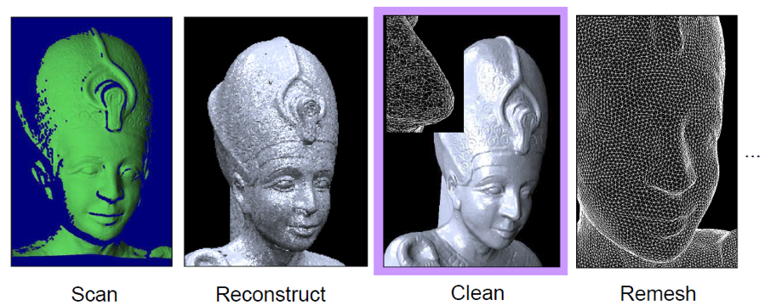
Mesh Processing Pipeline
<number> / 122
We will do cleaning/smoothing and remeshing today.
Remeshing (typically) followed by mesh deformation and/or 3D printing.

Slide 3
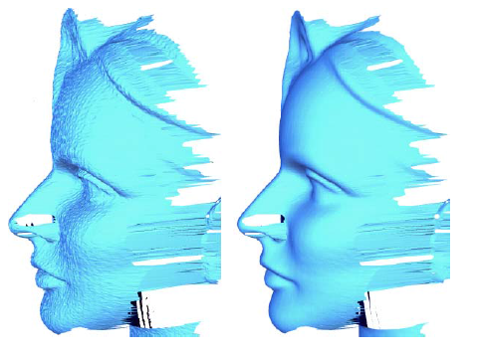
Mesh smoothing
<number> / 122
Idea: Filter out high frequency noise (common in scanners).
Noise causes feature vectors to be less consistent from dset to dset.
Alignments are more difficult to compute in the presence of noise.
Visually unattractive in games, movies, etc.

Slide 4
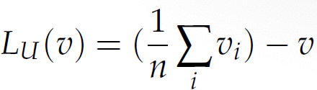
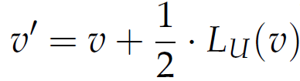
Mesh smoothing
<number> / 122
Solution: Uniform Laplace operator (Laplacian smoothing).
Do it in parallel, i.e., use original coordinates although they might have been updated previously.

Slide 5
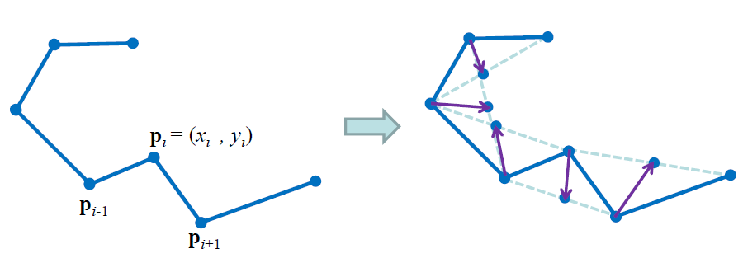
Mesh smoothing
<number> / 122
Illustration in 1D:

Slide 6
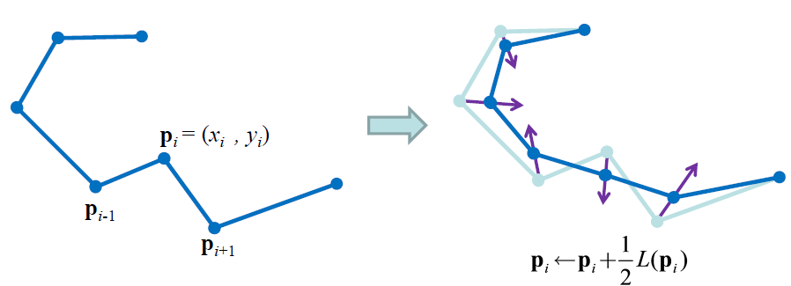
Mesh smoothing
<number> / 122
Illustration in 1D:

Slide 7
Mesh smoothing
<number> / 122
Observation: close curve converges to a single point?

Slide 8
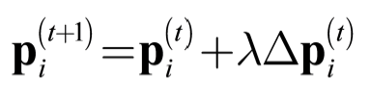
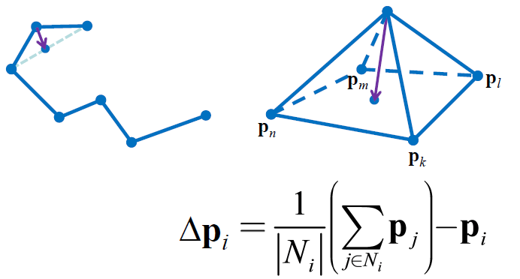
Mesh smoothing
<number> / 122
Illustration in 2D: Same as for curves (1D).

Slide 9
Mesh smoothing
<number> / 122
Observation: close mesh, e.g., sphere, converges to a single point.

Slide 10
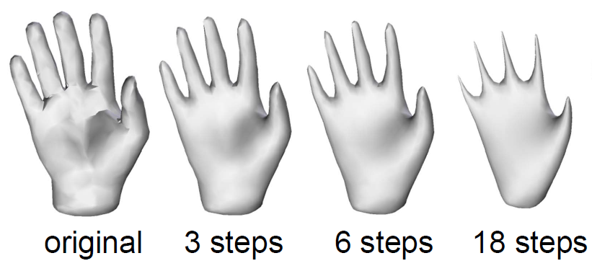
Mesh smoothing
<number> / 122
Observation: shrinkage problem.
Repeated iterations of Laplacian smoothing shrinks the mesh.

Slide 11
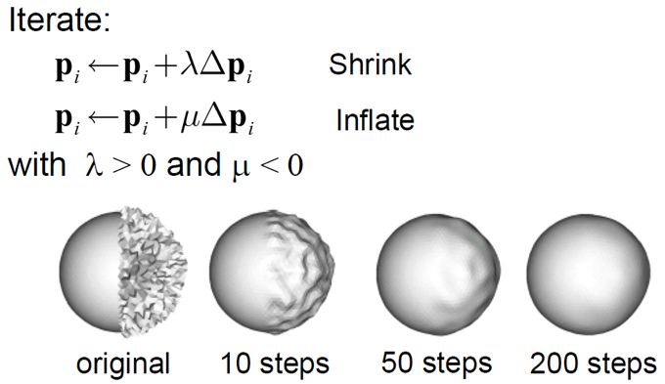

Mesh smoothing
<number> / 122
Solution2: shrinkage problem is remedied with an inflation term.
This is introduced by the Mesh Fairing paper by Taubin in 1995.

Slide 12
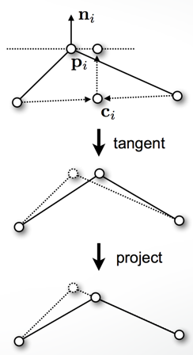
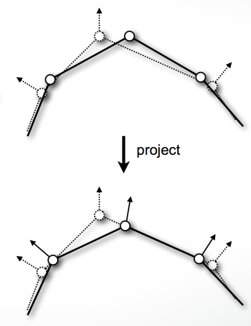

Mesh smoothing
<number> / 122
Solution2: shrinkage problem is remedied with tangential projection.

Slide 13
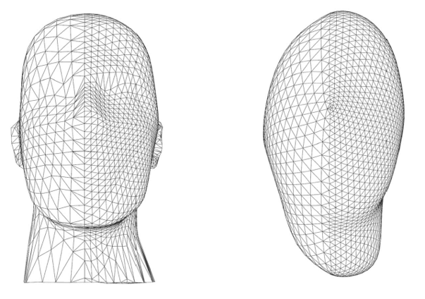
Mesh smoothing
<number> / 122
Another problem: Results based on uniform weighting depend on triangle shape.

Slide 14

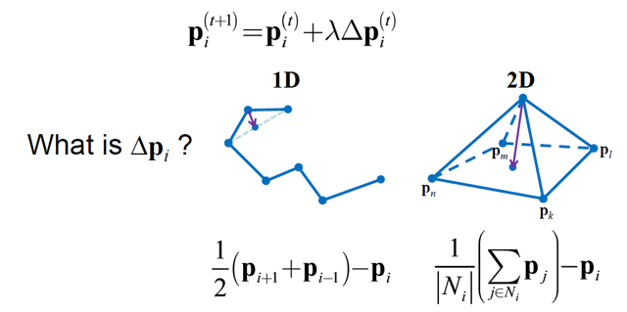
Mesh smoothing
<number> / 122
Another problem: Results based on uniform weighting depend on triangle shape.

Slide 15
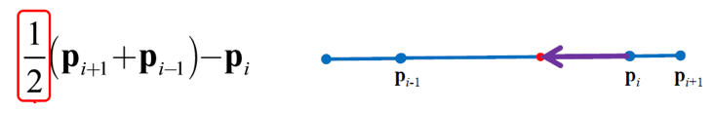
Mesh smoothing
<number> / 122
Another problem: Results based on uniform weighting depend on triangle shape.
Problem in 1D: same (uniform) weight for
both neighbors although one is closer.

Slide 16
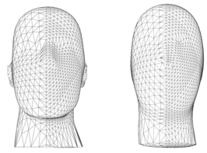
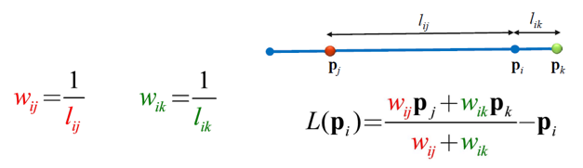
Mesh smoothing
<number> / 122
Another problem: Results based on uniform weighting depend on triangle shape.
Solution: use a smarter weight instead.
Straight 1D curves will be invariant to smoothing with this inverse distance weighting, i.e., L(p_{i}) = 0.

Slide 17
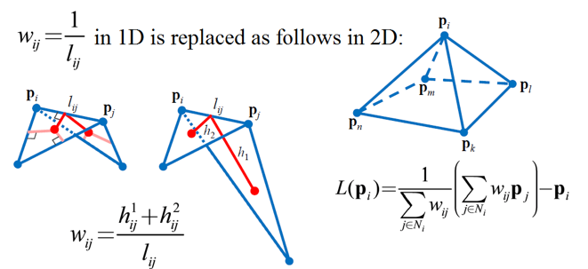
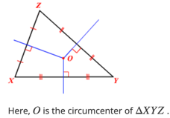
Mesh smoothing
<number> / 122
Another problem: Results based on uniform weighting depend on triangle shape.
Solution: use a smarter weight instead.
Same idea extends to 2D triangular surfaces
using cotangent weights.

Slide 18
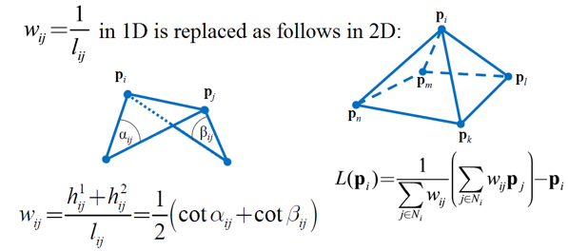
Mesh smoothing
<number> / 122
Another problem: Results based on uniform weighting depend on triangle shape.
Solution: use a smarter weight instead.
Same idea extends to 2D triangular surfaces
using cotangent weights.
Planar meshes will be invariant to smoothing ☺.

Slide 19
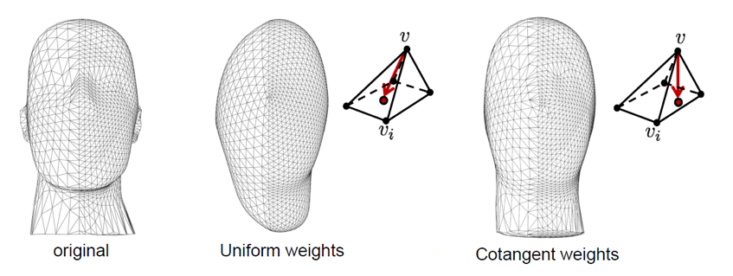
Mesh smoothing
<number> / 122
Another problem: Results based on uniform weighting depend on triangle shape.
Solution: use a geometry-aware weight instead; cotan weights in 2D.
pnts always in centroids geometry-aware
(original geometry ruined)

Slide 20
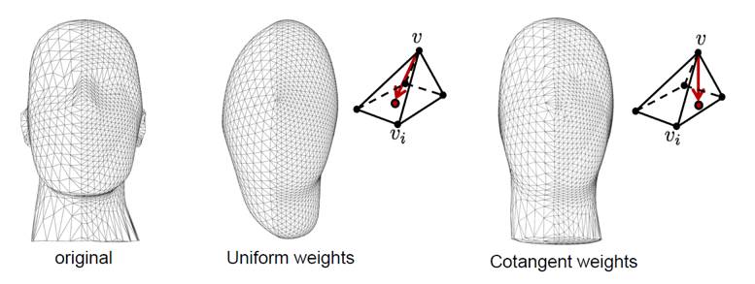
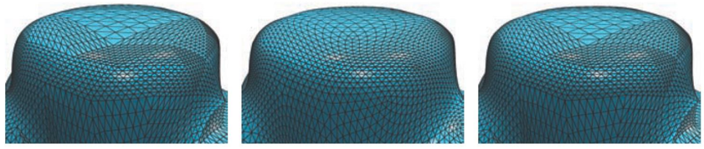
Mesh smoothing
<number> / 122
Another problem: Results based on uniform weighting depend on triangle shape.
Solution: use a geometry-aware weight instead; cotan weights in 2D.

Slide 21
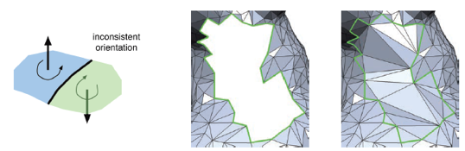
Remeshing
<number> / 122
Given a 3D mesh, compute another mesh, whose elements satisfy some quality requirements, while approximating the input acceptably.
In short, mesh quality improvement, aka Isotropic Remeshing.
Mesh quality: sampling density, regularity, and shape of mesh elements.
In contrast to Mesh Repairing*, the input of remeshing algorithms is usually assumed to be a manifold mesh in consistent orientation.
* See 3D Printing Slides 70-74.

Slide 22
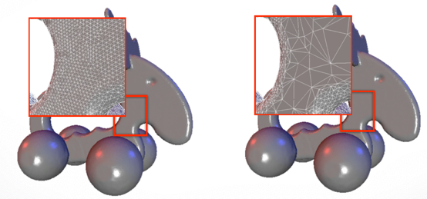
Remeshing
<number> / 122
Need remeshing to process acquisition hardware raw data for memory consumption reduction, computational efficiency and accuracy.
Remesh globally (from scratch).
3D scanners uniformly oversample to capture every possible detail without any a priori knowledge of the surface content (left).

Slide 23
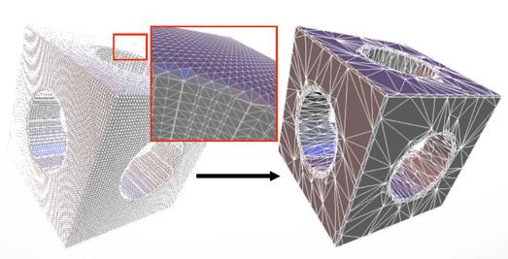
Remeshing
<number> / 122
Need remeshing to process acquisition hardware raw data for memory consumption reduction, computational efficiency and accuracy.
Remesh globally (from scratch).
Surface reconstruction algorithms, e.g., Marching Cubes isosurface extraction, over-tessellates to catch every possible detail (left).

Slide 24
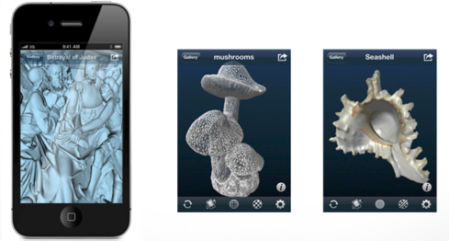
Remeshing
<number> / 122
Need remeshing to process acquisition hardware raw data for memory consumption reduction, computational efficiency and accuracy.
Remesh globally (from scratch).
3D content everywhere, including new hardware that are not as powerful and resourceful as the standard desktops/workstations.

Slide 25
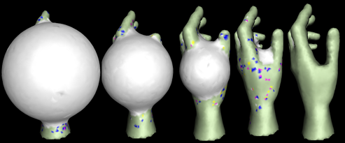
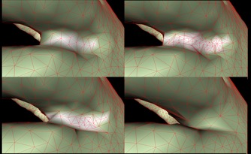
Remeshing
<number> / 122
Need remeshing ‘cos badly-shaped elements (triangle, tetrahedron) can endanger the numerical stability of simulations (plasticity, elasticity, fracture/breaking, tearing, etc.). Such a sim couldn’t run very far.
Remesh locally (only the trouble-maker elements).
Frozen neighborhood stops the OUT points early; remesh to give them enough power for further penetration ➔ mesh of adequate resolution.
Split edge if midpoint OUT: Shape from silhouette using topology-adaptive mesh deformation.

Slide 26

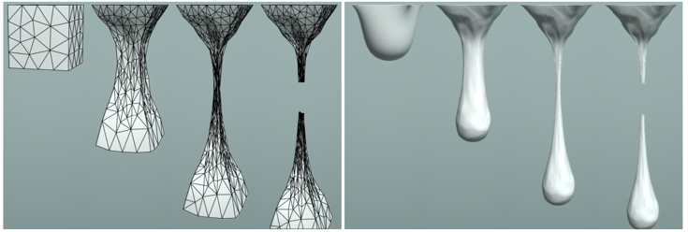
Remeshing
<number> / 122
Need remeshing ‘cos badly-shaped elements (triangle, tetrahedron) can endanger the numerical stability of simulations (plasticity, elasticity, fracture/breaking, tearing, etc.). Such a sim couldn’t run very far.
Remesh locally (only the badly-shaped elements).
A single mesh cannot represent all states of the obj being simulated.
Commit if element improves: greedy, fast, dynamic remeshing, sim-friendly.

Slide 27
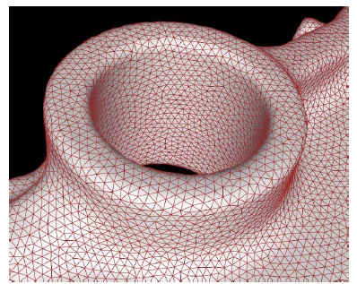
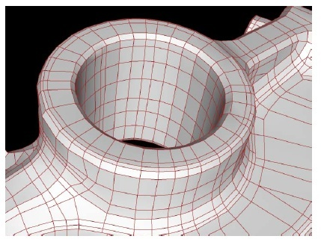
Remeshing
<number> / 122
Mesh elements: triangle vs. quadrangle.
+ simplest primitive.
+ heavily-optimized algorithms.
+ specialized hardware.

Slide 28
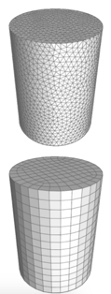
Remeshing
<number> / 122
Mesh elements: triangle vs. quadrangle.
+ aligns to principal curvature dirs.
+ sub-d friendly.
+ anisotropy w/o bad angles.

Slide 29
Remeshing
<number> / 122
Mesh elements: triangle vs. quadrangle.
Advantages of triangle meshes (more popular than quads).
  Four points or more may not be on the same plane, but three points always are (unambiguous unless colinear). This has the interesting property that scalar values vary linearly over the surface of the triangle.
  This, in turn, means a lot for shading, texture mapping. A simple (barycentric) lerp, which can be done extremely fast in specialized hardware, is sufficient.
  Triangles are the simplest* primitive, so algorithms dealing with triangles can be heavily optimized, e.g., fast point-in-triangle test.
  * every object can be split into triangles but a triangle cannot be split into anything other than triangles.

Slide 30


Remeshing
<number> / 122
Mesh elements: triangle vs. quadrangle.
Advantages of quad meshes.
  For surface PDE problems, such as fluid and cloth simulations, quad mesh is a natural representation that simplifies the formulation of the problem.
  Catmull-Clark subdivision surfaces work with quad meshes.
  NURBS models require a quadrangular base domain.
  Anisotropy without bad angles:
  Bilinear interpolation instead of barycentric interpolation //not an advantage.

Slide 31
Remeshing
<number> / 122
Mesh elements: triangle vs. quadrangle.
Quad to tri conversion?
Tri to quad conversion?
Notes:
Latter: connect center w/ 3 mid-edges.

Slide 32
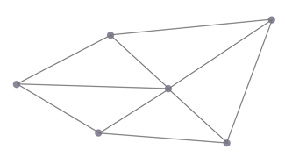
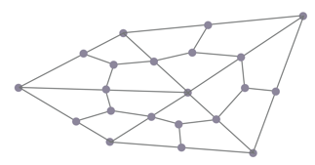
Remeshing
<number> / 122
Mesh elements: triangle vs. quadrangle.
Quad to tri conversion? Connect the disconnected within each quad.
Tri to quad conversion? Catmull-Clark split.
Notes:
Latter: connect center w/ 3 mid-edges.

Slide 33
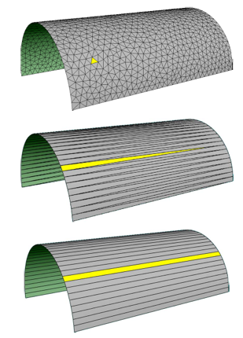
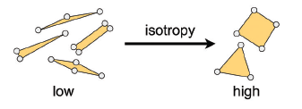
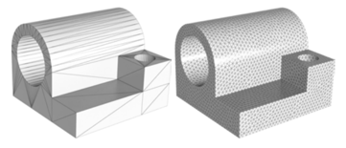
Remeshing
<number> / 122
Mesh quality criterion, shape: isotropic vs. anisotropic.
The shape of isotropic elements is locally uniform in all directions. Ideally, a triangle/quadrangle is isotropic if it is close to equilateral/square.

Slide 34


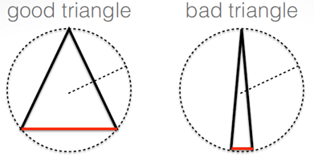
Remeshing
<number> / 122
Mesh quality criterion, shape: isotropic vs. anisotropic.
The shape of isotropic elements is locally uniform in all directions. Ideally, a triangle/quadrangle is isotropic if it is close to equilateral/square.
Isotropic elements: roundness ~ 1. (favored in numerical apps, FEM).
Roundness: ratio of circumcircle radius to the length of the shortest edge.

Slide 35
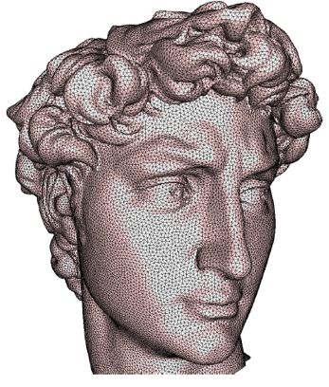
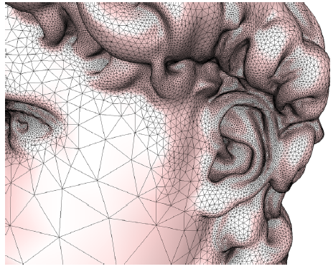
Remeshing
<number> / 122
Mesh quality criterion, sampling: uniform vs. adaptive.
Smaller elements are assigned to areas w/ high curvature.

Slide 36
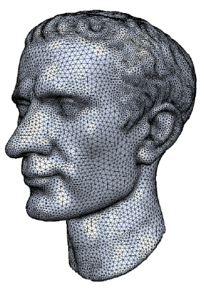
Remeshing
<number> / 122
Mesh quality criterion, sampling: uniform vs. adaptive.
Smaller elements are assigned to areas w/ high curvature.

Slide 37
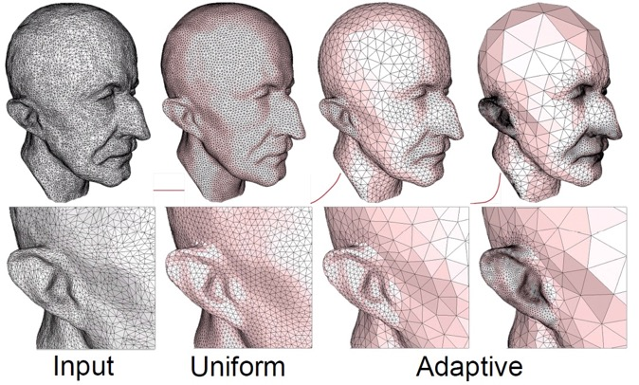
Remeshing
<number> / 122
Mesh quality criterion, sampling: uniform vs. adaptive.
Smaller elements are assigned to areas w/ high curvature.

Slide 38
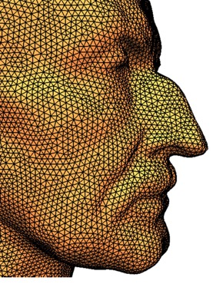
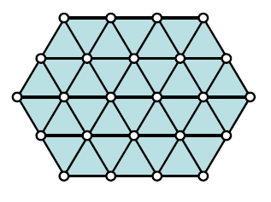
Remeshing
<number> / 122
Mesh quality criterion, regularity: irregular vs. regular.
Valence close to 6; ~equal edge lengths.

Slide 39
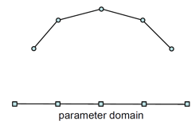
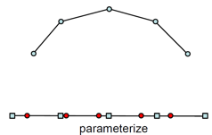
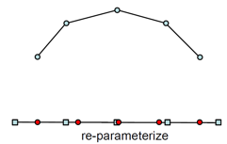
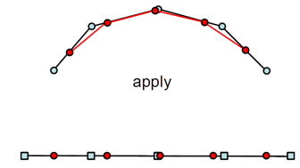
Remeshing
<number> / 122
Remeshing approaches: parameterization-based vs. surface-based.
(variational) (incremental)
Param-based: map to 2D, do the remeshing (2D problem), lift it up.
reds distributed better.
← reds lifted up.

Slide 40
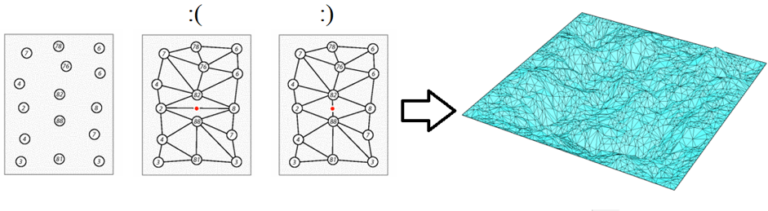
Remeshing
<number> / 122
Remeshing approaches: parameterization-based vs. surface-based.
Param-based: map to 2D, do the triangulation (2D problem), lift it up.
Delaunay triangulation: maximize the min angle = no point inside the circumcircle of a triangle.

Slide 41

Remeshing
<number> / 122
Remeshing approaches: parameterization-based vs. surface-based.
Param-based: map to 2D, do the triangulation (2D problem), lift it up.
Obtain a cool distribution via Centroidal Voronoi Diagram, then lift up.
  Compute Voronoi diagram of the given points pi (black).
  Move points pi to centroids ci (red) of their Voronoi cells vi.
  Repeat above until satisfaction.

Slide 42
Remeshing
<number> / 122
Remeshing approaches: parameterization-based vs. surface-based.
Param-based: map to 2D, do the distribution (2D problem), lift it up.
Obtain a cool distribution via Centroidal Voronoi Diagram, then lift up.
CVD can also be computed directly on the surface (Incremental remeshing approach). See paper: Isotropic Surface Remeshing Using Constrained Centroidal Delaunay Mesh.

Slide 43

Remeshing
<number> / 122
Remeshing approaches: parameterization-based vs. surface-based.
Param-based: map to 2D, do the triangulation (2D problem), lift it up.
  See my Mesh Parameterization slides for the details of 3D to 2D mapping.

Slide 44

Remeshing
<number> / 122
Remeshing approaches: parameterization-based vs. surface-based.
Param-based: map to 2D, do the triangulation (2D problem), lift it up.
  See my Mesh Parameterization slides for the details of 3D to 2D mapping.
  //b: area-equalized
  version of a.
  //c: edges discarded.
  //d: 2D mesh to be lifted.

Slide 45

Remeshing
<number> / 122
Remeshing approaches: parameterization-based vs. surface-based.
Surface-based: work directly on the mesh embedded in 3D.

Slide 46

Remeshing
<number> / 122
Remeshing approaches: parameterization-based vs. surface-based.
Surface-based: work directly on the mesh embedded in 3D.
Generic algo.
  Specify edge length range [Lmin, Lmax].
  Collapse edges shorter than Lmin.
  Split edges longer than Lmax (or decide based on endpnts’ curvatures).
  Flip edges to get closer to valence 6 (Euler).
  Vertex shift by Laplace smoothing.
Lmax = 4/3L and Lmin = 4/5L where L is the target edge length.

Slide 47


Remeshing
<number> / 122
Remeshing approaches: parameterization-based vs. surface-based.
Surface-based: work directly on the mesh embedded in 3D.
Split 4/3L Collapse 4/5L

Slide 48


Remeshing
<number> / 122
Remeshing approaches: parameterization-based vs. surface-based.
Surface-based: work directly on the mesh embedded in 3D.
  Flip edges to get closer to valence 6 (interior), 4 (boundary).
    Compute sum above before and after flip; if decreases, do it.

Slide 49


Remeshing
<number> / 122
Remeshing approaches: parameterization-based vs. surface-based.
Surface-based: work directly on the mesh embedded in 3D.
Beware of illegal edge collapses:
i) Normal flip after collapse! ii) intersection of 1-ring neighborhood of i and j contains 3+ vertices!

Slide 50

Remeshing
<number> / 122
Remeshing approaches: parameterization-based vs. surface-based.
Surface-based: work directly on the mesh embedded in 3D.
Beware of bad series of edge collapses:
☹
i) A heuristic while removing short edges:
Collapse into the vert w/ higher valence.
Works ‘cos high-valence verts stay fixed and ☺
every collapse reduces # adjacent short edges.

Slide 51

Remeshing
<number> / 122
Remeshing approaches: parameterization-based vs. surface-based.
Surface-based: work directly on the mesh embedded in 3D.
Beware of illegal edge splits:
☹
☺
i) Infinite-loop problem if you split shorter edges first (top row)!

Slide 52

Remeshing
<number> / 122
Remeshing approaches: parameterization-based vs. surface-based.
Surface-based: work directly on the mesh embedded in 3D.
Beware of illegal edge flips:
i) edge is adjacent to 2 tris whose union is not a convex quadrilateral!
convex if no projection (of the 4th vert) is inside the tri (defined by the
other 3 verts) //4th vert is projected to the plane defined by the other 3.

Slide 53

Remeshing
<number> / 122
Remeshing approaches: parameterization-based vs. surface-based.
Surface-based: work directly on the mesh embedded in 3D.
Feature preservation during remeshing is an important issue.
Don’t flip feature edges.
Collapse only along features. Project to feature curves.
Don’t touch corner vertices.

Slide 54

Remeshing
<number> / 122
Remeshing approaches: parameterization-based vs. surface-based.
Surface-based: work directly on the mesh embedded in 3D.
A sequence of edge collapses, aka mesh decimation:

Slide 55

Remeshing
<number> / 122
Remeshing approaches: parameterization-based vs. surface-based.
Surface-based: work directly on the mesh embedded in 3D.
Mesh decimation/simplification has goals and trade-offs.

Slide 56

Remeshing
<number> / 122
Generic algorithm for mesh decimation/simplification:
  Put all edges into a priority queue Q keyed on some cost function.
    A common cost function is the length of an edge.
  While Q not empty
    Extract min from Q //edge to be contracted.
    Collapse edge.
    Update local costs for neighboring edges.

Slide 57

Remeshing
<number> / 122
Edge length as a cost function is intuitive (get rid of small edges) but not so robust.
Original Cost = length Cost = random

Slide 58

Remeshing
<number> / 122
Edge length as a cost function is intuitive (get rid of small edges) but not so robust.
Original Better costs (next slides)

Slide 59

Remeshing
<number> / 122
Cost for edge collapses (other than edge length cost).
Curvature factor is introduced as coplanar surfaces can be represented using fewer polygons than areas w/ a high curvature.
Good collapses:
Bad collapses:

Slide 60

Remeshing
<number> / 122
Cost for edge collapses (other than edge length cost).
Curvature factor is introduced as coplanar surfaces can be represented using fewer polygons than areas w/ a high curvature.
Cost of collapsing u to v: Tu is the set of triangles that contain the vertex u and Tuv is the set of triangles that share the edge (u,v).
Cost is length (||u-v||) multiplied by a curvature factor (< 1).
Curvature factor computed by comparing the dot products of all involved face normals to find the largest angle b/w 2 faces.

Slide 61


Remeshing
<number> / 122
Cost for edge collapses (other than edge length cost).
Error quadric: based on the observation that in the original model each vertex is the solution of the intersection of a set of planes.
Such a set of planes is associated w/ each vertex as supporting planes.
The error at the vertex w.r.t. this set is the sum of squared distances to its supporting planes.
  Surface Simplification Using Quadric Error Metrics, Garland & Heckbert, ’97.
This error helps preserving the original details in the decimated model.
Edge-length metric: Error quadric metric:

Slide 62

Remeshing
<number> / 122
Cost for edge collapses (other than edge length cost).
Error quadric in 1D (supporting planes → supporting lines).
Put u to the center or median of neighbors. to a place that minimizes quadric err., i.e., sum of distances to support lines.

Slide 63



Remeshing
<number> / 122
Cost for edge collapses (other than edge length cost).
First associate a symmetric 4x4 Q matrix to each vertex v = [x y z 1]^{T}.
  Just 10 floating points per vertex (symmetric 4x4: see Slide 67).
Define the error at v as: d(v) = v^{T} Q v.
For a given contraction (v1, v2) → v’, use Q’ for the error: d(v’) = v’^{T} Q’ v’ where Q’ = Q1 + Q2.
v1=u, v2=v, v’=v in this example.
d(v’) will be high: bad collapse.

Slide 64


Remeshing
<number> / 122
Cost for edge collapses (other than edge length cost).
First associate a symmetric 4x4 Q matrix to each vertex v = [x y z 1]^{T}.
  Just 10 floating points per vertex (quite compact).
Define the error at v as: d(v) = v^{T} Q v.
For a given contraction (v1, v2) → v’, use Q’ for the error: d(v’) = v’^{T} Q’ v’ where Q’ = Q1 + Q2.
Contraction point v’ is the point that minimizes d(v’).
  For this, we set the partial derivatives of d(v’) to zero, yielding
Can be verified by taking partl dervs of:
Quadric surfaces are the graphs of any equation that can be put
into the general form: Ax² + By² + Cz² + Dxy + Exz + Fyz + Gx + Hy + Iz + J = 0.

Slide 65


Remeshing
<number> / 122
Cost for edge collapses (other than edge length cost).
If matrix below has no inverse, then we use v1, v2, or midpoint as v’.
  Not invertible in flat areas.

Slide 66
Remeshing
<number> / 122
Cost for edge collapses (other than edge length cost).
Algo is then:
  Compute Q matrices for all vertices.
  Select all valid pairs (connected by edge, or too close).
  Compute contraction point v’ for each valid pair (v1, v2). The error v’^{T} (Q1+Q2) v’ becomes the cost of contraction.
    Note that v’^{T} (Q1+Q2) v’ = v’^{T} Q1 v’ + v’^{T} Q2 v’.
  Place all pairs into a min heap keyed on costs.
  Extract min pair, contract it, update costs of the involved pairs.
v’^{T} Q1 v’: sum of the distances² of the supporting planes of v1 to v’.
v’^{T} Q2 v’: sum of the distances² of the supporting planes of v2 to v’.
Only remaining issue: what are the initial Q matrices?

Slide 67


Remeshing
<number> / 122
Cost for edge collapses (other than edge length cost).
Q: error at each vertex is the sum of the squared distances of the supporting planes to that vertex.
If contraction point of u is v, then we have a high distance to plane t1.

Slide 68

Remeshing
<number> / 122
Cost for edge collapses (other than edge length cost).
Q: error at each vertex is the sum of the squared distances of the supporting planes to that vertex.

Slide 69



Remeshing
<number> / 122
Cost for edge collapses (other than edge length cost).
Q captures this error if it is defined in the following way:
p0v0 + p1v1 + p2v2, dot product, meaning the
length of the projection of v on plane normal
n = [p0, p1, p2]^{T}.
Kp can be used to find the squared distance of any point in space to the plane p. We can sum them into Q and represent an entire set of planes by a single matrix Q.
Note that the initial error estimate d(v) for each vertex is 0, since each vertex lies in the planes of all its incident triangles.
d(v)
d(v) =

Slide 70

Remeshing
<number> / 122
Cost for edge collapses.
Recall plane equation to understand d(v) better:
p0, p1, p2, p3 become
A, B, C, D here.
Cool plane generator: https://technology.cpm.org/general/3dgraph/

Slide 71
Remeshing
<number> / 122
Cost for edge collapses (other than edge length cost).
Replacing distance to supporting planes error metric with distance to one-ring neighbors error metric.
  More efficient as 5 floats per vertex stored instead of 10 (Slide 61).
d(v) = ∑ ||v – vi||² = ∑ (v – vi)^{T}(v – vi) = ∑ v^{T}v – 2v^{T} ∑ vi + ∑ vi^{T}vi = n v^{T}v – 2v^{T} ∑ vi + ∑ vi^{T}vi (we’ve n neighbors around v (sum 1 to n)).
5 floats: n, ∑ vi (has 3 components), ∑ vi^{T}vi to be applied to v for d(v).
Contraction point is the minimum of d(v), hence set derv to 0, yielding 2nv - 2 ∑ vi = 0 ➔ v’ = (∑ vi) / n is the contraction point.

Slide 72

Remeshing
<number> / 122
Progressive meshes as an option to undo remeshing on the fly.
Alternating vertex split and edge collapse operations.
  Progressive meshes, H. Hoppe, 1996.

Slide 73

Remeshing
<number> / 122
Progressive meshes as an option to undo remeshing on the fly.
Good for view-dependent rendering (LOD).

Slide 74

Remeshing
<number> / 122
Progressive meshes as an option to undo remeshing on the fly.
Good for view-dependent rendering (LOD).

Slide 75

Remeshing
<number> / 122
Progressive meshes as an option to undo remeshing on the fly.
Good for distance-dependent rendering (LOD).

Slide 76

Remeshing
<number> / 122
Progressive meshes as an option to undo remeshing on the fly.
Good for distance-dependent rendering (LOD).

Slide 77


Subdivision Surfaces
<number> / 122
Related to remeshing.
Sub-d surface: a method to represent a smooth surface via a coarser polygon mesh (base mesh).
Take base mesh.
Subdivide it; creating new vertices and faces (like our edge split).
Compute positions of new verts based on positons of nearby old verts.

Slide 78


Subdivision Surfaces
<number> / 122
Related to remeshing.
Sub-d surface: a method to represent a smooth surface via a coarser polygon mesh (base mesh).
Take base mesh.
Subdivide it; creating new vertices and faces (topology update).
Compute positions of new verts based (geometry update).

Slide 79


Subdivision Surfaces
<number> / 122
Instead of updating a parameter t along a parametric curve (Bezier) or parameters u, v over a parametric grid (NURBS), subdivision surfaces repeatedly refine from a coarse set of control points.
  Sub-d surface is an alternative to NURBS patches.
  NURBS patches are hard to join with nice
  continuity across an edge or a corner.
  Cubic Bezier Curve:

Slide 80

Subdivision Surfaces
<number> / 122
Instead of updating a parameter t along a parametric curve (Bezier) or parameters u, v over a parametric grid (NURBS), subdivision surfaces repeatedly refine from a coarse set of control points.
  Sub-d surface is an alternative to NURBS patches.
  NURBS patches are hard to join with nice
  continuity across an edge or a corner.
Each step of refinement adds new faces and vertices.
The process converges to a smooth limit surface.

Slide 81


Subdivision Curves
<number> / 122
Approximating curve (nearby control points); there’s also interpolating curves (through control points).
Split each edge in two.
-- topology update --

Slide 82

Subdivision Curves
<number> / 122
Approximating curve (nearby control points); there’s also interpolating curves (through control points).
Relocate each original vertex.
-- geometry update --
Rule: halfway through the center of (new) neighbors, like Laplacian smoothing.

Slide 83




Subdivision Curves
<number> / 122
Approximating curve (nearby control points); there’s also interpolating curves (through control points).
Start over. Split. Relocate.
Limit curve.

Slide 84
Subdivision Curves
<number> / 122
Approximating curve (nearby control points); there’s also interpolating curves (through control points).
Same effect if the geometry rule is changed as follows (Catmull-Clark):
  All (not just the originals) are moved in triplets. Middle is weighted by 6/8 and left-right by 1/8; hence the filter/mask: (1/8, 6/8, 1/8).
Limit curve.

Slide 85

Subdivision Curves
<number> / 122
Corner cutting.
Insert two new vertices at ¼ and ¾ of each edge.
Remove the old vertices.
Connect the new vertices.

Slide 86


Subdivision Curves
<number> / 122
Corner cutting.
Application of this scheme to a non-closed base (polyline) gives:
aka Chaikin curve subdivision (1974).

Slide 87





Subdivision Curves
<number> / 122
Corner cutting.
Application of this scheme to a non-closed base (polyline) gives:
aka Chaikin curve subdivision (1974).

Slide 88




Subdivision Curves
<number> / 122
Corner cutting.
Application of this scheme to a closed base (polygon) gives:

Slide 89


Subdivision Curves
<number> / 122
Chaikin can be coded as follows:
k is the generation. Each gen has twice as many ctrl pnts as before.
Note that even and odd ctrl pnts are generated differently.
Borders, if any, are treated specially.

Slide 90

Subdivision Curves
<number> / 122
Chaikin can be coded as follows:
This vector notation compresses the scheme to a kernel:
Eigenanalysis of this matrix proves continuity of the limit curve.
  Turns out that the limit curve is a quadratic B-spline.

Slide 91


Subdivision Surfaces
<number> / 122
Categorization:
Notes:
Based on: http://graphics.stanford.edu/courses/cs468-10-fall/LectureSlides/10_Subdivision.pdf

Slide 92

Subdivision Surfaces
<number> / 122
Categorization of classical schemes:

Slide 93


Subdivision Surfaces
<number> / 122
Catmull-Clark subdivision to refine quad surfaces/meshes.
Let’s expand these equations into ready-to-code statements.

Slide 94

Subdivision Surfaces
<number> / 122
Catmull-Clark subdivision to refine quad surfaces/meshes.
Base mesh Catmull-Clark
limit surface

Slide 95

Subdivision Surfaces
<number> / 122
Catmull-Clark subdivision to refine quad surfaces/meshes.
Base mesh Catmull-Clark
limit surface

Slide 96

Subdivision Surfaces
<number> / 122
Catmull-Clark subdivision to refine quad surfaces/meshes.
Weighted averages of the original verts used to compute new geometry.
A face point is computed using these 4 weights.

Slide 97

Subdivision Surfaces
<number> / 122
Catmull-Clark subdivision to refine quad surfaces/meshes.
Weighted averages of the original verts used to compute new geometry.
An edge point is computed using these 6 weights.

Slide 98

Subdivision Surfaces
<number> / 122
Catmull-Clark subdivision to refine quad surfaces/meshes.
Weighted averages of the original verts used to compute new geometry.
A vertex point is computed using these 7 weights.

Slide 99


Subdivision Surfaces
<number> / 122
Catmull-Clark subdivision to refine quad surfaces/meshes.

Slide 100



Subdivision Surfaces
<number> / 122
√3-subdivision to refine triangular surfaces/meshes.
  https://www.graphics.rwth-aachen.de/media/papers/sqrt31.pdf
Step 2: move each original vertex v to a new position p by averaging v with the positions of its original neighboring vertices v_{i} for 0≤i≤n-1.

Slide 101

Subdivision Surfaces
<number> / 122
√3-subdivision.
Loop subdivision.

Slide 102

Subdivision Surfaces
<number> / 122
4-to-1 subdivision.
  For each edge e=(u,v), which is shared by triangles t1 and t2
    Split e from the middle to replace t1 w/ 2 triangles and t2 w/ 2
    Add the new edge to set F if it connects original vertex to the
    new split-vertex (middle) and it is neither u nor v.
  Flip each edge in F
An interpolating scheme as the original vertex locations are not updated/approximated.

Slide 103


Subdivision Surfaces
<number> / 122
Loop subdivision to refine triangular surfaces/meshes.

Slide 104

Subdivision Surfaces
<number> / 122
Loop subdivision to refine triangular surfaces/meshes.

Slide 105

Subdivision Surfaces
<number> / 122
Loop subdivision to refine triangular surfaces/meshes.

Slide 106



Subdivision Surfaces
<number> / 122
Doo-Sabin subdivision to refine quad surfaces/meshes. Both quad and triangle faces in the output.

Slide 107

Subdivision Surfaces
<number> / 122
Doo-Sabin subdivision to refine quad surfaces/meshes. Both quad and triangle faces in the output.

Slide 108

Subdivision Surfaces
<number> / 122
Doo-Sabin subdivision scheme; e.g., converts cube to sphere.

Slide 109

Subdivision Surfaces
<number> / 122
Doo-Sabin subdivision scheme; e.g., converts cube to sphere.
Take centers of each polygonal face (not has to be quads).

Slide 110

Subdivision Surfaces
<number> / 122
Doo-Sabin subdivision scheme; e.g., converts cube to sphere.
(Virtually) connect centers to the parent polygon’s vertices.

Slide 111

Subdivision Surfaces
<number> / 122
Doo-Sabin subdivision scheme; e.g., converts cube to sphere.
Take midpoints of the virtual connectors.
All these midpnts are the next generation of pnts generated by base.

Slide 112

Subdivision Surfaces
<number> / 122
Doo-Sabin subdivision scheme; e.g., converts cube to sphere.
Connect this new generation as shown above (creates axis-aligned quads).

Slide 113

Subdivision Surfaces
<number> / 122
Doo-Sabin subdivision scheme; e.g., converts cube to sphere.
More connections (creates slopped triangles; called corner-cutting).
Other side not shown for visual clarity. Continue for a refined sphere.

Slide 114

Subdivision Surfaces
<number> / 122
Doo-Sabin subdivision scheme; e.g., converts cube to sphere.
Certain combinations of the surrounding vertices: subdivision mask.
Subdivision mask decides the new vertex coordinates.
Here (1/2, 1/2) mask is used ‘cos midpnts are selected.

Slide 115


Subdivision Surfaces
<number> / 122
Butterfly subdivision to refine triangular surfaces/meshes (interpolting).

Slide 116

Subdivision Surfaces
<number> / 122
Related to remeshing.
Sub-d surface: a method to represent a smooth surface via a coarser polygon mesh (base mesh).
Loop subdivision scheme by Charles Loop, 1987.

Slide 117

Subdivision Surfaces
<number> / 122
Related to remeshing.
Sub-d surface: a method to represent a smooth surface via a coarser polygon mesh (base mesh).

Slide 118

Subdivision Surfaces
<number> / 122
Related to remeshing.
Sub-d surface: a method to represent a smooth surface via a coarser polygon mesh (base mesh).
Like progressive meshes you can use it for efficient distance-dependent rendering (LOD).

Slide 119




Subdivision Surfaces
<number> / 122
Related to remeshing.
Sub-d surface: a method to represent a smooth surface via a coarser polygon mesh (base mesh).
Not a (Gouraud) shading trick; actually changing the geo. of the model.

Slide 120

Subdivision Surfaces
<number> / 122
Related to remeshing.
Sub-d surface: a method to represent a smooth surface via a coarser polygon mesh (base mesh).
Phong Tessellation, 2008, is an interpolating subdivision and does not exhibit the shrinking effects of the approximating refinement schemes, e.g., Loop or Catmull-Clark subdivision.
Idea: use tangent planes at mesh vertices to replace triangles with quadratic patches for smoother display.
Compute linear tessellation.
Project the resulting point orthogonally onto
the 3 tangent planes defined by the triangle verts.
3. Compute barycentric interp. of these projections.

Slide 121

Subdivision Surfaces
<number> / 122
Related to remeshing.
Sub-d surface: a method to represent a smooth surface via a coarser polygon mesh (base mesh).
Phong Tessellation, 2008, is an interpolating subdivision and does not exhibit the shrinking effects of the approximating refinement schemes, e.g., Loop or Catmull-Clark subdivision.
Idea: use tangent planes at mesh vertices to replace triangles with quadratic patches for smoother display.

Slide 122
Potential Project Topics
<number> / 122
Normal orientation correction: naïve algorithm (neighbor triangles have similar normals) vs. simple this algorithm:
  https://www.cs.utah.edu/~ladislav/takayama14simple/takayama14simple.html
Mesh repairing using http://www.cgal.org/gsoc/2012.html#holefill
  3D Printing Slides 70-74 also useful.
Implementing: Interactive Geometry Remeshing //parameterization-based remeshing.
Implementing: Isotropic Surface Remeshing without Large and Small Angles, or Isotropic Surface Remeshing using Constrained Centroidal Delaunay Mesh //surface-based remeshing.

